Slide 1
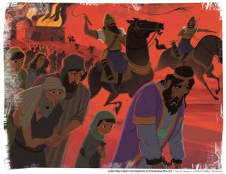
Experiencing God in Exile
2 Kings 17 and 1 Peter

Slide 2
The Bible Pattern of Exile

Slide 3
5 Movements in 1–2 Kings
Solomon’s Reign (1 K 1–11)
Israel Splits into Two (1 K 12–16)
Israel’s Kings vs. Prophets (1 K 17–2 K 8)
Road to Assyrian Exile (2 K 9–17)
Road to Babylonian Exile (2 K 18–25)

Slide 4
Bible Idea from 2 Kings 17
After 200 years of rebellion against prophetic warning, the northern kingdom of Israel fell to Assyria and went into exile.

Slide 5
Outline of 2 Kings 17
Hoshea reigned in Israel (vv. 1–5).
Assyria captured Samaria and displaced the people (vv. 6).
The writer summarized the reasons for Israel’s exile (vv. 7–23).
Assyria resettled the northern kingdom with foreign people groups (vv. 24–41).

Slide 6
The People Failed to Actively Remember the Exodus
God’s goodness, power, grace, and faithful acts for Israel
Did result in . . . Should have resulted in . . .
Corrupt ethics Undivided allegiance
Ignoring word of God Faith
Idolatry Pure worship

Slide 7
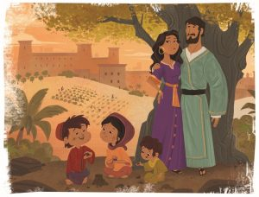
The Prophet Hosea
The prophet’s own marriage and family became a picture of the spiritual unfaithfulness of Israel, but also of the faithful love of God toward his unfaithful people.

Slide 8
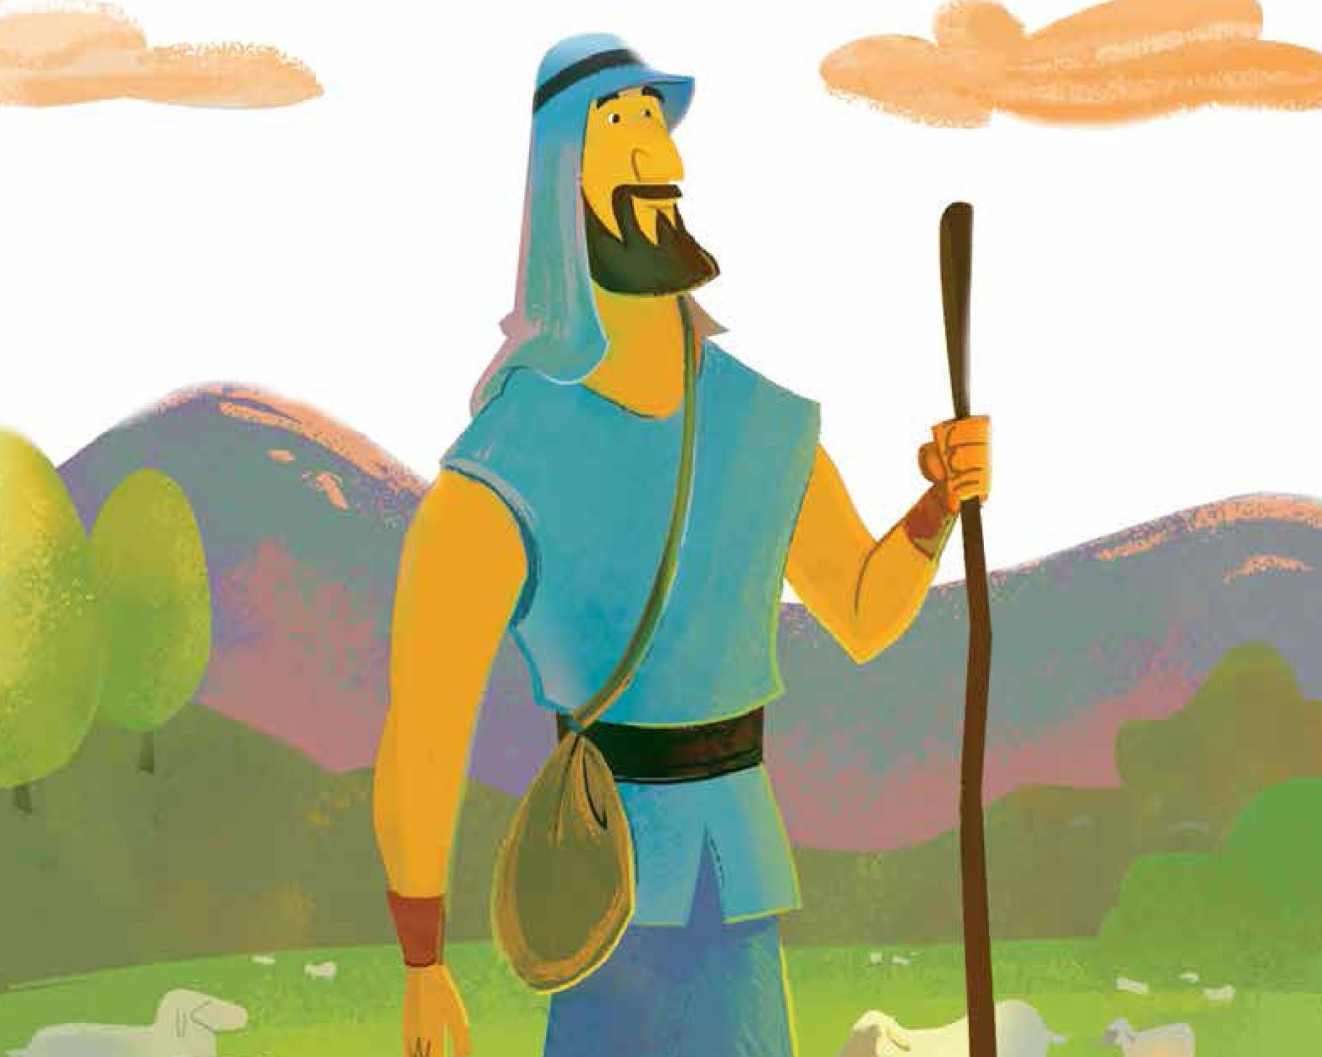
The Prophet Amos
The prophet Amos was a shepherd by trade, not a prophet. Yet God called him to deliver one of the darkest revelations in the prophetic writings. Even in the darkest moment of rebellion, God still promised redemption.

Slide 9
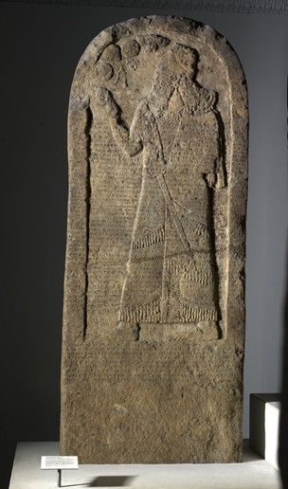
Further Historical Evidence for the Assyrian Captivity
The Kurkh Stele discovered in 1861 (c. 852 B.C.)
“[In the year 853 B.C., the 6th year of Shalmanesser III] Karkar, his royal city, I destroyed, I devastated, I burned with fire. 1,200 chariots, 1,200 cavalry, 20,000 soldiers, of Hadad-ezer, of Aram (Damascus?); 700 chariots, 700 cavalry, 10,000 soldiers of Irhuleni of Hamath, 2,000 chariots, 10,000 soldiers of Ahab, the Israelite . . .”

Slide 10
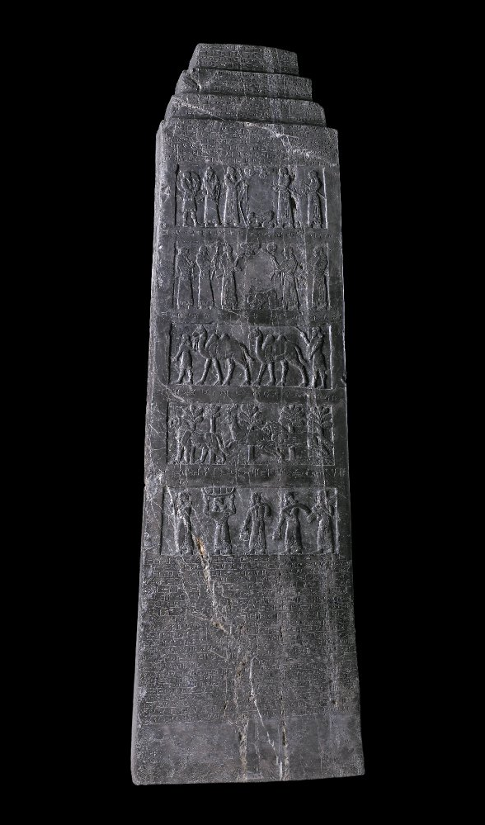
Further Historical Evidence for the Assyrian Captivity
The Black Obelisk discovered in 1845 (c. 825 B.C.)
“Tribute ofIaua (Jehu), son of Omri (mar Hurnri). Silver, gold, a golden bowl, a golden beaker, golden goblets, pitchers of gold, lead, staves for the hand of the king, javelins, I received from him.”

Slide 11
Further Historical Evidence for the Assyrian Captivity
The Taylor Prism discovered in 1830 (c. 701–691 B.C.)
“As for Hezekiah, the Jew, who did not submit to my yoke, 46 of his strong cities, as well as the small cities in their neighborhood, which were without number—by levelling with battering rams and by bringing up siege engines, I besieged and took (those cities)” (p. 11).

Slide 12
Further Historical Evidence for the Assyrian Captivity
The Taylor Prism discovered in 1830 (c. 701–691 B.C.)
“200,150 people, great and small, male and female, horses, mules, asses, camels, cattle and sheep, without number, I brought away from them and counted as spoil. Himself, like a caged bird I shut up in Jerusalem, his royal city. Earthworks I threw up against him—the one coming out of the city-gate, I turned back to his misery” (p. 11).

Slide 13
Outline of 2 Kings 17
Hoshea reigned in Israel (vv. 1–5).
Assyria captured Samaria and displaced the people (vv. 6).
The writer summarized the reasons for Israel’s exile (vv. 7–23).
Assyria resettled the northern kingdom with foreign people groups (vv. 24–41).

Slide 14
Reasons for Israel’s Exile
Sinned against God, who saved them out of Egypt.
Feared other gods.
Walked in customs of other nations.
Followed example of idolatrous Israelite kings.
Led secret lives.
Built false worship places.
Made offerings to false gods.
Did wicked things to serve idols.

Slide 15
Reasons for Israel’s Exile
Despised God’s statutes, covenant, and warnings.
Went after false idols and became false themselves.
Followed nations instead of the Lord.
Abandoned the Lord’s commandments.
Made metal images of two calves.
Worshiped and served Asherah and Baal.
Burned their sons and daughters as offerings.
Practiced divination and sold themselves to do evil.

Slide 16
Outline of 2 Kings 17
Hoshea reigned in Israel (vv. 1–5).
Assyria captured Samaria and displaced the people (vv. 6).
The writer summarized the reasons for Israel’s exile (vv. 7–23).
Assyria resettled the northern kingdom with foreign people groups (vv. 24–41).

Slide 17
Therefore, the Lord was very angry with Israel, and removed them out of his sight. None was left but the tribe of Judah.
2 Kings 17:18

Slide 18
The Bible Pattern of Exile

Slide 19
Timeless Truth from 2 Kings 17
Sin against God always leads to an exilic experience.
Distance
Oppression
Temptation

Slide 20
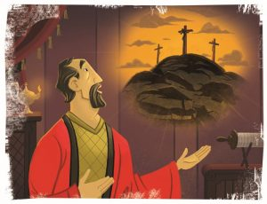
Christ-centered Timeless Truth
Jesus became an exile—literally and symbolically.
Jesus accepted distance, oppression, and temptation by entering into our exile from God, paying for our sin debt to God, so that we may experience God’s presence during our exilic sojourn and one day make it home to him through Christ. Because of him, we are no longer exiled from God, but we are exiles in the world.

Slide 21
Timeless Truth from Jeremiah 29:7
Exilic experiences can be transformed to fit God’s overall plan and glory.
Distance Transformed into Mission
Oppression Transformed into Endurance
Temptation Transformed into Loyalty

Slide 22
Do We Fail to Actively Remember the Cross? If so . . .
God’s goodness, power, grace, and faithful acts for us
May result in . . . But should result in . . .
Corrupt ethics Undivided allegiance
Ignoring word of God Faith
Idolatry Pure worship

Slide 23
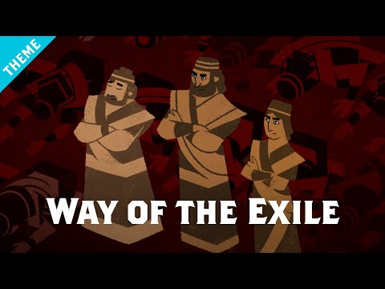
The Bible Pattern of Exile

Slide 24
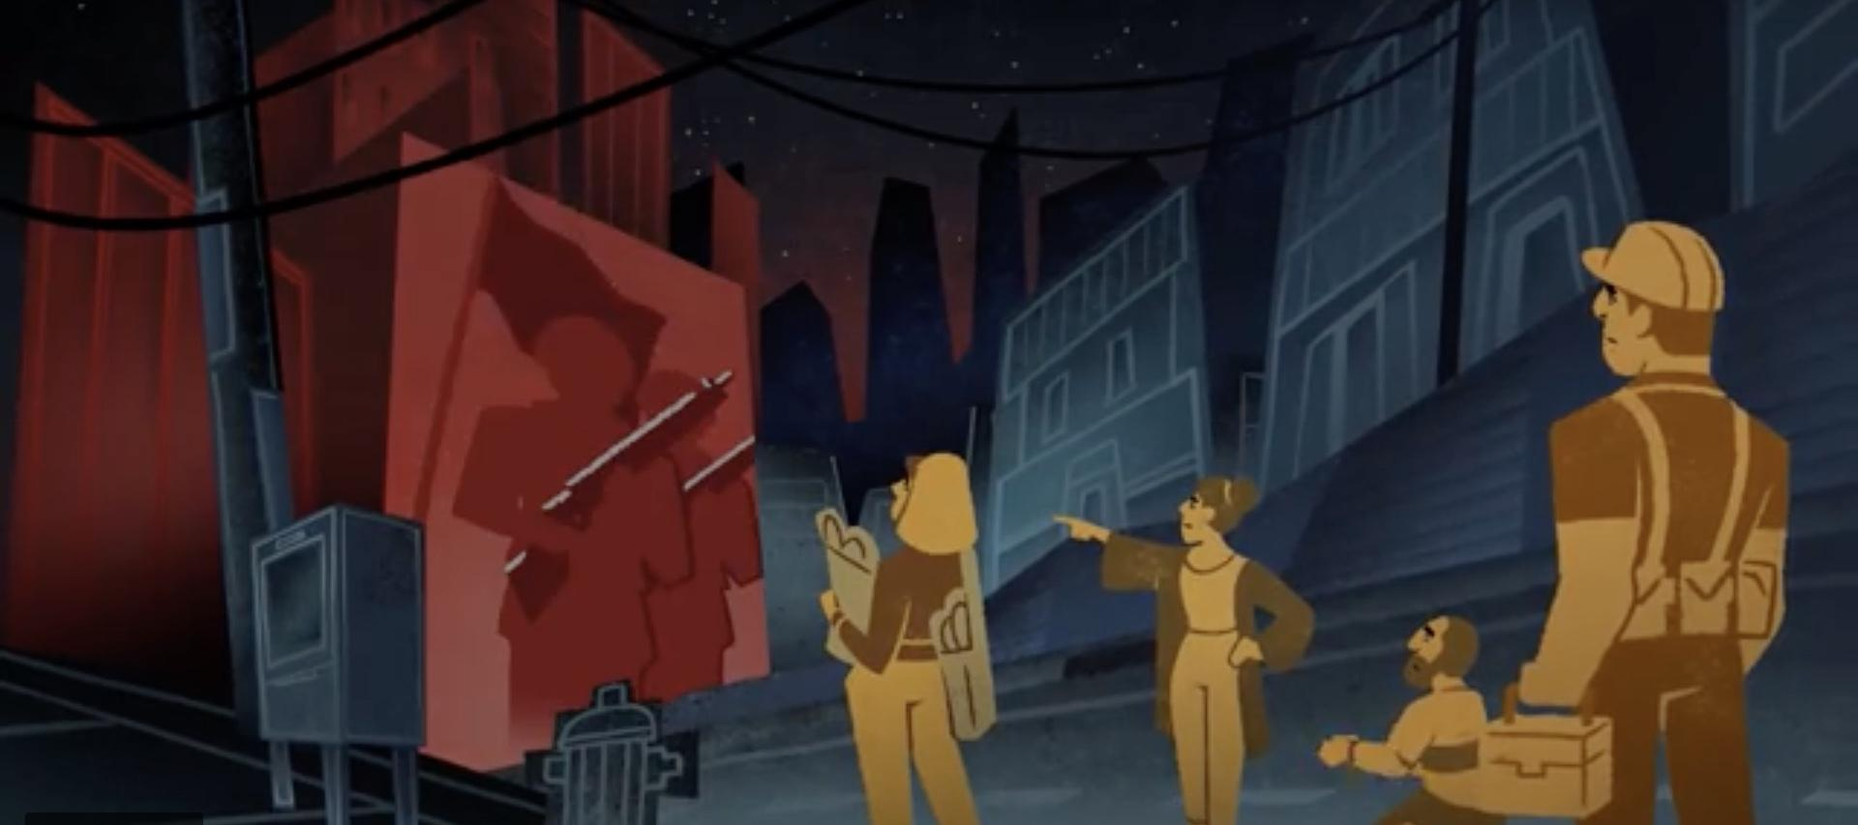
The Way of Exile Today: 1 Peter tells us the way.
Παροικία — the state of being in a strange locality without citizenship
Παρεπίδημος — pertaining to staying for a while in a strange or foreign place, sojourning

Slide 25
The Way of Exile Today: 1 Peter tells us the way.
Submit to God for a sanctifying sojourn.

Slide 26
5 Ways to Submit to God for a Sanctifying Sojourn
from 1 Peter
Be born again into an exilic experience (1:1, 3, 23; 2:4–10).
Be made holy instead of crusading against culture, resisting the culture wars, or adopting the culture (1:17; 2:1, 11–12).
Accept the call to a submissive life (2:13–3:7).
Suffer for righteousness’ sake (3:8–4:19).
Accept the call to exilic shepherding (5:1–11).

Slide 27
Choose to Grow with Others Today at 10:15am
The Gospel Project for Kids begins here;
Teen Bible Studies are located in the Youth & Fireside Rooms.
Sermon 2.0
with Rex Howe
Located in the Fellowship Hall
Faith Enduring Through Adversity
with Paul Zabel
Located in the Fellowship Hall
The Tech-Wise Family
with Pete Meyer
Located in the Gymnasium

Slide 28
Experiencing God in Exile
2 Kings 17 and 1 Peter

